Slide 1
Nonresponse Bias: Three Paradoxes
Presented at the 26th International Workshop on Household Survey Nonresponse
Leuven, Belgium
Roger Tourangeau, Westat
September 3, 2015

Slide 2
Three Paradoxes
Why is the nonresponse rate so poorly related to nonresponse bias?
Are alternative indicators any better?
Can we reduce bias or accomplish other objectives through responsive design?

Slide 3
The Relationship between NR Rate and NR Bias
The theory
How can there not be a relationship?
Portion due to zero propensity cases
Portion due to nonzero propensity cases

Slide 4
The Findings
Six widely cited studies suggest little or no relationship
Curtin, Presser, and Singer (2000)
Groves (2006)
Groves and Peytcheva (2008)
Keeter, Miller, Kohut, Groves, and Presser (2000)
Keeter, Kennedy, Dimock, Best, and Craighill (2006)
Merkle and Edelman (2002)

Slide 5
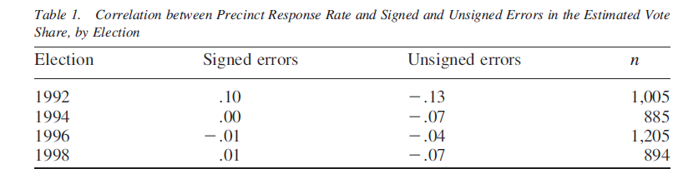
Merkle and Edelman
Looked at relationship between response rates and errors in exit polls

Slide 6
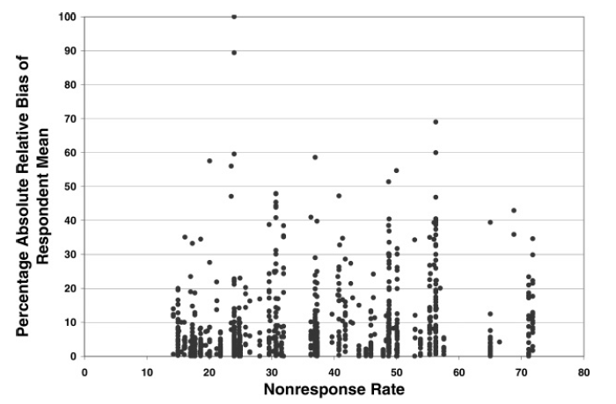
Groves and Peytcheva (2008)
Looked at 59 studies with bias estimates (959 estimates)

Slide 7
Groves and Petcheva (cont’d)
Most comprehensive look
Two conclusions
Little or no relation between n-r bias and n-r rate
Tremendous with study variability
Second conclusion is very important because it means that no study-level indicator can tell us much about the n-r bias

Slide 8
Reanalysis
Absolute relbias can be a misleading statistic: (2%-1%)/1%=absolute relbias of 100%
I looked at absolute error in 422 proportions (out of 556 estimates Peytcheva provided)
Statistics | Absolute Diff | Absolute Relbias
Proportions only (individual stats) | -.339 ( 422) | -.286 (422)
Proportions only (study-level means) | -.025 (41) | -.333 (41)
ANOVA (R squared) | .576 | .343

Slide 11
Reanalysis Conclusions
There is a relation between n-r rate and n-r bias
Some study level characteristics beside n-r rate are important (e.g., method of estimating bias)
Big differences in bias by study; study accounts for most of the variance

Slide 12
Some Theories accounting for Low Relationship
No bias in general
Propensities determined by study-level features (e.g., distance of interviewer from exit from precinct)
Propensities essentially random, product of many highly variable characteristics of R
Low bias
Propensities stable across many design features; design features determine overall RR
Propensities stable but determined by R characteristics unrelated to survey variables
Hidden bias
Observed propensities truncated; bias produced by zero propensity cases

Slide 13
No Bias
Response propensities largely a function of design characteristics (e.g., advance letter, incentives, mode of data collection, interviewer skill, length of field period, number and timing of contact attempts; survey sponsor, whether survey is mandatory); these are completely unrelated to respondent characteristics, including survey variables
Response propensities essentially random: a product of a large number of R characteristics, many of them transient (temporary illness, how busy at work, call screening policies, travel schedule, mood, whether R reads advance letter, etc.)

Slide 14
Low Bias
Contrary to leverage-salience theory, same people are more likely to respond regardless of topic and sponsor; more formally, base response propensity plus main effects for various design characteristics, such as mode and incentives
For example, regardless of mode, surveys overrepresent older, more educated, more prosperous people, people living outside central cities, those who own their homes, have landlines, etc.
Bias similar whatever overall RR

Slide 15
Hidden Bias
The problem is not the people with some propensity of responding
Instead, there is a large bias component that reflects growing segment of the population with essentially no chance of taking part (see Slide 3)
For example, with a telephone survey, 50 percent are in zero propensity stratum; rest (15-20 percent of the other stratum who do respond) essentially a product of chance factors

Slide 16
Relation Nonlinear
When propensities very low (telephone survey) or very high (mandatory FTF survey), little variation in response propensities and therefore little bias
Overall, the RR-bias relationship is non-monotonic

Slide 17
Paradox 2: Alternatives to the Response Rate
Schouten and his colleague have proposed the R-indicator and Särndal has proposed the balance indicator as alternatives to the response rate of the threat of bias
Both have a lot of appeal
R Indicator
If propensities are constant (and non-zero) then threat of bias is eliminated (for all variables)
Thus, variance (or SD) of propensities should be a good indicator of threat
Balance indicator is also good proxy for bias
Distance of Rs from a vector of population targets
D is a vector of differences between the means for the respondents and for the full sample or population on the auxiliary variables; Ʃs is a cross-products matrix for the auxiliaries

Slide 18
Problems with the Alternatives
Both share an issue: If within-study variation in bias swamps between-study variance, no one number will ever be an adequate indicator; this is a key problem
R-indicator has some additional problems
Only as good as the propensity model (bad model suggests propensities don’t vary much)
Doesn’t seem to vary much
Simulations suggest it is not a good indicator of bias (Beaumont, Bocci, and Haziza, 2014)
Balance indicator—overall distance from frame variables or other auxiliaries may not be good proxy for distance between Rs and non-respondents on survey variables

Slide 19
Paradox 3: Responsive/Adaptive Design
Responsive designs: Designs with multiple phases, with aim of achieving less biased, more representative sample (Groves and Heeringa, 2006); American Community Survey has done this all along (mail, telephone, FTF for a subsample)
Adaptive designs: Designs tailored from the outset (Luiten and Schouten, 2013) or adapted continuously throughout the field period Peytchev, Riley, Rosen, Murphy, and Lindblad, 2010)

Slide 20
Do These Designs Work? Luiten and Schouten (2013)
The control group for the experiment was the regular SCS (CATI-only)
Experimental group: two phases of data collection.
Phase 1
Cases with low cooperation propensities were sent a mail questionnaire;
Those with the highest propensities invited to complete a web survey;
Those with intermediate propensities were given a choice

Slide 21
Luiten and Schouten (2013)—(Cont’d)
Phase 2: NR follow-up by telephone
Those in the highest contact propensity quartile were fielded later and were called during the day;
Those in the second highest contact propensity quartile were called twice at night and then switched to a schedule that alternated daytime and nighttime calls;
Those in the lowest two contact propensity quartiles were called on every shift of every day.
The best telephone interviewers were assigned to cases with the lowest cooperation propensities and the worst telephone interviewers were assigned to those with the highest cooperation propensities.

Slide 22
Luiten and Schouten (2013)—Results
Contact Propensity Quartile | Contact Rates
 | Experimental | Control
Lowest Contact Propensity Second Lowest Contact Propensity Second Highest Contact Propensity Highest Contact Propensity | 87.1 96.6 93.7 95.3 | 84.2 94.5 95.7 96.9
Cooperation Propensity Quartile | Cooperation Rates
 | Experimental | Control
Lowest Cooperation Propensity Second Lowest Cooperation Propensity Second Highest Cooperation Propensity Highest Cooperation Propensity | 65.1 71.4 72.8 74.7 | 62.7 68.4 75.3 79.2

Slide 23
Luiten and Schouten (2013)—Discussion
Overall, the experimental, adaptive field work group had a slightly higher response rate than the regular SCS cases (63.8 percent versus 62.8 percent, a non-significant difference).
The representativeness of the experimental sample was significantly higher than that of the control sample (R-indicators of .85 and .77, respectively)
Less variation in rates across quartiles

Slide 24
Ideal Intervention
Two phase design: At end of Phase 2, want all propensities to be as close to equal as possible
If p_{1i} > k then stop; overall propensity is p_{1i} ; otherwise, move on to second phase
Phase 2 propensity is, in the ideal, k - p_{1i} : In Phase 2 work low propensity cases harder than high propensity cases or change protocol somehow
If that can be achieved (it cannot), then bias is reduced:

Slide 25
Some Practical Limits to Responsive/ Adaptive Design
Often, don’t know how to raise propensities; three moves common in U.S. surveys
Change mode (e.g., move to face-to-face)
Increase incentive
Shorter questionnaire
Obstacles to all three
If we knew what to do, would have done it from the beginning!
Often easier to lower propensities of high propensity cases by limiting effort on them (Lundquist and Särndal, 2013; Särndal and Lundquist, 2014)

Slide 26
Conclusions
NR rate not a worthless indicator; R indicator and balance indicator may be better, but there is a significant relation between NR rate and NR bias
Not clear that NR bias isn’t strongly related to study characteristics; if it isn’t, any study-level indicator will not be much help
Not clear why relation between RR and NR bias not stronger or more linear—I outlined six possiblities
We don’t know how to raise response propensities in current environment; optimal strategy is to adjust field work to reduce variation in overall propensities

